Slide 1
FORTAX: a tax and benefit microsimulation library
Jonathan Shaw and Andrew Shephard
PRELIMINARY RESULTS – DO NOT CITE

Slide 2
What FORTAX is
A UK tax and benefit calculator
1990 onwards
Working-age families
Written in Fortran

Slide 4
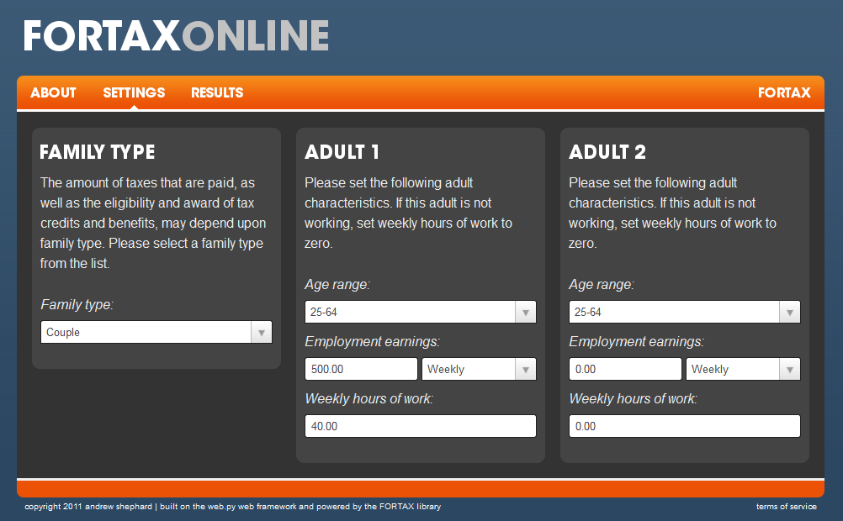

Slide 5
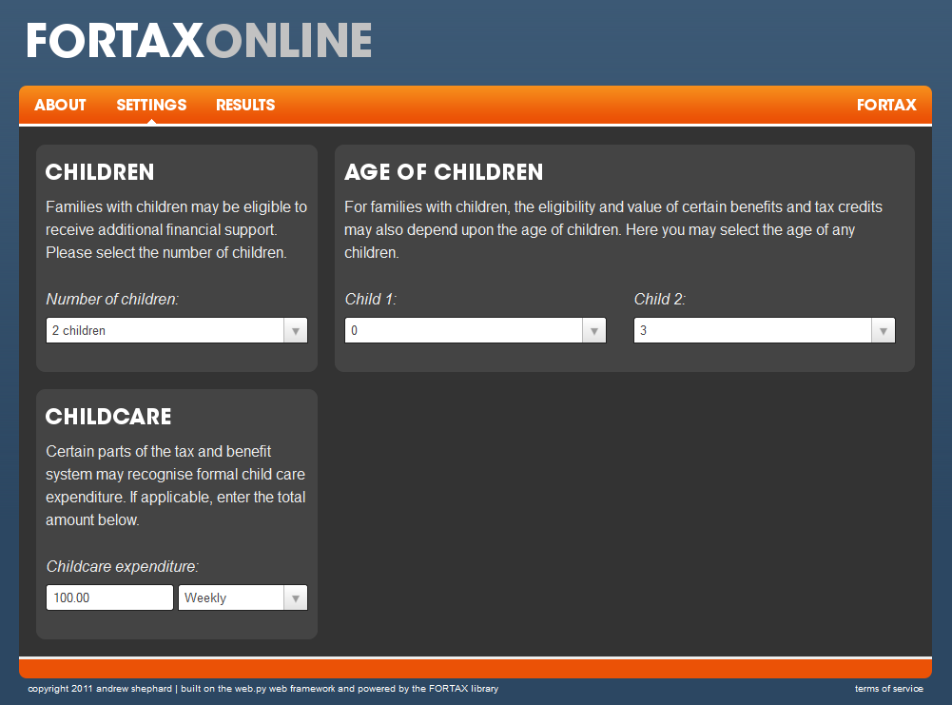

Slide 6
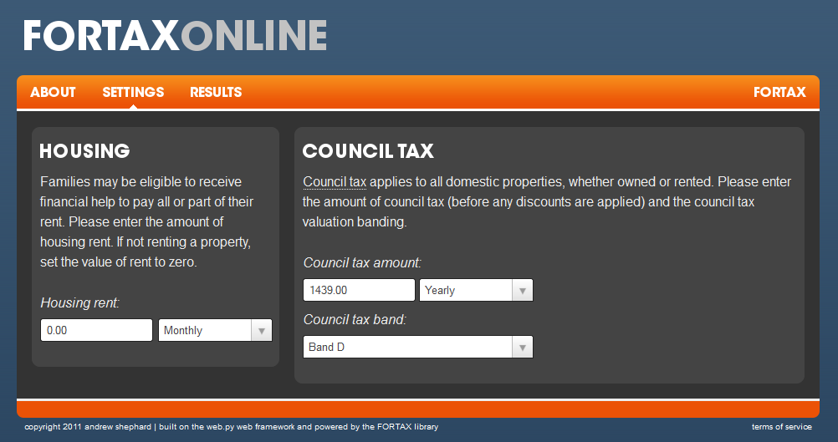

Slide 9
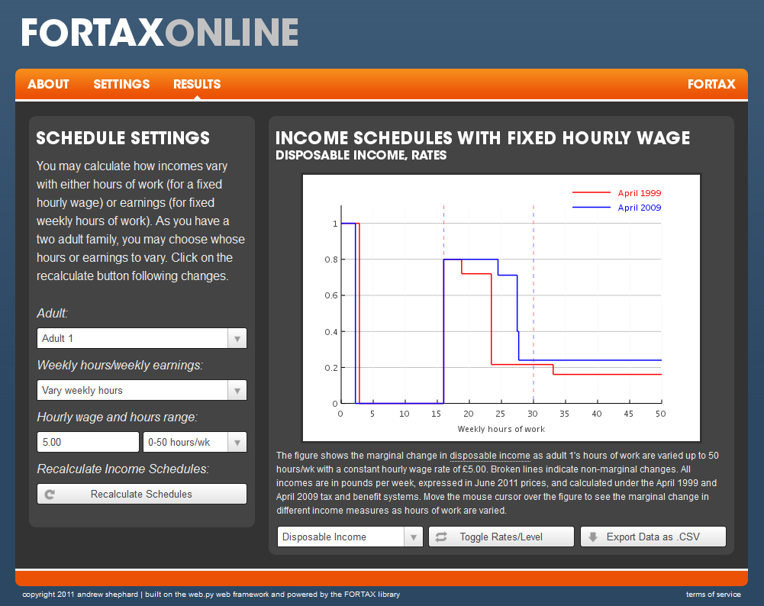

Slide 10
How FORTAX works
A basic call:
call calcNetInc(sys,fam,net)
Tax system intent(in)
Net income intent(out)
Family characteristics intent(in)

Slide 11
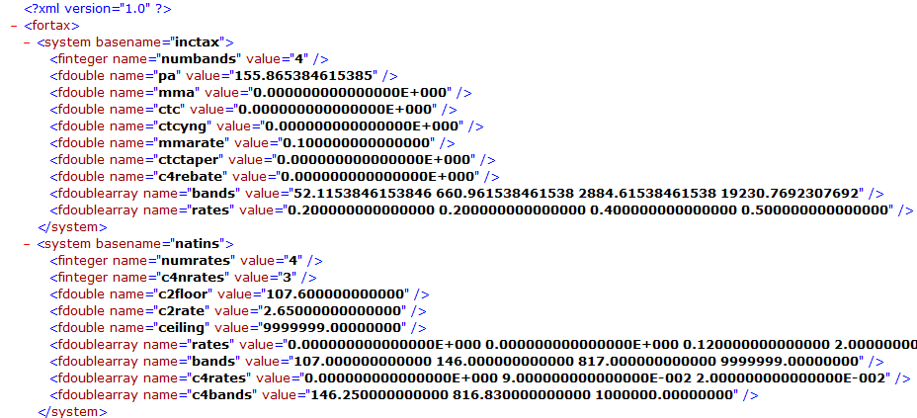
How FORTAX works: tax system files
Tax systems stored as .xml files
Read and written using xml-fortran library by Arjen Markus

Slide 12
How FORTAX works: family characteristics
Populate the fam structure
fam = fam_gen(married=.true., age1=25, age2=25, hrs1=16.0_8, &
earn1=144.0_8, hrs2=0.0_8, earn2=0.0_8, kidage=(/0/))

Slide 13
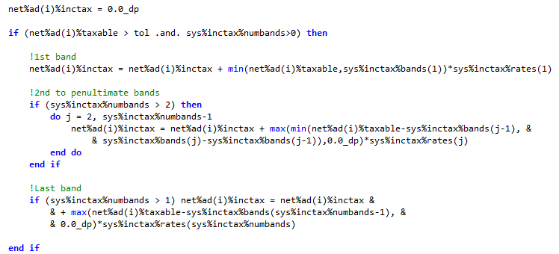
How FORTAX works: tax calculation
A basic call:
call calcNetInc(sys,fam,net)
Income tax calculation code:

Slide 14
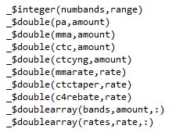
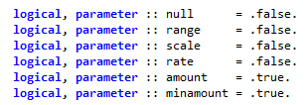
How FORTAX works: uprating and updating
Frequent need to express tax systems in different years’ prices
Frequent need to update (or correct!) tax system implementation
Simplified using preprocessor macros
if (.true.) sys%inctax%pa = factor*sys%inctax%pa

Slide 15
Why Fortran?
Need fast implementation
Existing code in Fortran
(Anecdotally, other economists seem to justify their choice similarly)

Slide 16
An application: estimating the effect of tax credit reforms on female decisions
Richard Blundell, Monica Costa Dias, Costas Meghir and Jonathan Shaw
PRELIMINARY RESULTS – DO NOT CITE

Slide 17
What we do
Construct a lifecycle model of female labour supply, human capital and savings
Eckstein and Wolpin (1989) and (1999), Keane and Wolpin (1997), Adda et al (2008), Todd and Wolpin (2006), Eckstein and Lifshitz (2011)
Estimate parameters using British panel data (BHPS)
Study effect of tax credit reforms on education and employment decisions over the lifecycle

Slide 18
Advances over standard approaches
Features of traditional welfare evaluations (e.g. Brewer et al, 2006):
Estimate impact of particular reform packages
Use static framework
Focus on short-run labour supply response
Counter-examples: Ham and Lalonde (1996), Todd and Wolpin (2006), Haan and Prowse (2010), etc
This work: first attempt to study UK tax and benefit system in dynamic context
Focus is on female response to UK tax credit reforms
Dynamic effects via education, experience, productivity and family composition
Also investigate impact on education

Slide 19
Background: UK tax credit reforms
Award for family with one child aged 0-10 (£ per week, nominal terms)
 | April 1999 (FC) | April 2002 (WFTC) | April 2004 (WTC and CTC)
Basic award | £64.95 | £88.95 | £101.63
30-hour premium | £11.05 | £11.65 | £12.31
Earnings threshold | £80.65 | £94.50 | £97.31 and £961.54
Taper rate | 70% of net earnings | 55% of net earnings | 37% and 6.67% of gross earnings
Help with childcare | Disregard up to £60 childcare expenses | Maximum award increased by 70% of childcare expenses up to £135 | Maximum award increased by 70% of childcare expenses up to £135
Note: Families with children are eligible if at least one adult works 16+ hours. Help with childcare requires all adults to work 16+ hours. The increase in generosity between WFTC and WTC/CTC is exaggerated because the reform also incorporated elements of other benefits.

Slide 20
Background: UK tax credit reforms (2)

Slide 21
Background: UK tax credit reforms (3)

Slide 22
Literature: employment impact of WFTC
+ 2-7ppt increase in employment rate for lone parents
Smaller, possibly negative impact for second earners in couples
Blundell et al (2005), Brewer et al (2006), Francesconi and van der Klaauw (2004), Francesconi et al (2009)

Slide 23
Literature: impact of WFTC on other outcomes
Anticipation employment effects
Unknown
Couple formation and dissolution
Mixed evidence (Francesconi and van der Klaauw (2004), Gregg et al (2007), Francesconi et al. (2009))
Childbearing
Fall in fertility for lone parents, rise for couples (Francesconi and van der Klaauw, (2004), Brewer et al (2008))
=> May undermine existing employment estimates

Slide 24
Model: overview of female lifecycle
Life in three stages:
Education (up to 18/21)
Secondary, A-levels or university (determines type of human capital)
Working life (18/21-59)
Labour supply {0hrs, 20hrs, 40hrs} and consumption
Partnering and childbearing
Retirement (60-69)
Consumption only

Slide 25
Model: dynamics of family income
Female wage
Depends on education, experience, persistent productivity shock
Experience accumulates while working
(Exogenous) family formation dynamics
Children
Model youngest child
Characterised by age
Arrival probability depends on female age, education, presence of partner and older children
Departure with certainty when child reaches age 18
Partners
Characterised by education, employment status and wage
Arrival probability for male with given education depends on female age and education
Departure probability depends on female age, presence of child and male education
Detailed model of tax and benefit system (FORTAX)

Slide 26
Model: decision-making environment
Risk averse individuals faced with uncertainty
Own productivity (health)
Family dynamics: partnering/separation, child bearing
Partner employment and income
No insurance market
Only implicit insurance through human capital, savings and public policy
Credit constraints during working life
So public policy may facilitate transfers across lifecycle
Decisions taken to maximise expected lifetime utility

Slide 27
Model: data and estimation
Model estimated using BHPS data:
Unbalanced panel of 5,300 females over 16 waves, 1991–2006
Multi-step estimation procedure
Fix a few parameters
Estimate some parameters outside structural model
Male employment and wages
Family dynamics and childcare costs
Estimate remaining parameters by method of simulated moments (MSM)
Parameters include: cost of education, female wage equation, experience accumulation, taste for employment, distribution of unobserved heterogeneity
Results below based on data simulated by the model

Slide 28
Model fit: female log hourly wage

Slide 29
Model fit: female employment rate

Slide 30
Model fit: female employment rate by age of child

Slide 31
Employment effects of tax credit reforms
 | All women |  |  |  | Single women
 | All | No child | Mothers | Child left | All | No child | Mothers | Child left
2002 vs 1999
All | -0.004 | 0.006 | -0.016 | 0.002 | 0.020 | 0.010 | 0.051 | 0.005

Slide 32
Employment effects of tax credit reforms
 | All women |  |  |  | Single women
 | All | No child | Mothers | Child left | All | No child | Mothers | Child left
2002 vs 1999
All | -0.004 | 0.006 | -0.016 | 0.002 | 0.020 | 0.010 | 0.051 | 0.005
GCSEs | -0.003 | 0.013 | -0.016 | 0.003 | 0.034 | 0.024 | 0.063 | 0.009

Slide 33
Employment effects of tax credit reforms
 | All women |  |  |  | Single women
 | All | No child | Mothers | Child left | All | No child | Mothers | Child left
2002 vs 1999
All | -0.004 | 0.006 | -0.016 | 0.002 | 0.020 | 0.010 | 0.051 | 0.005
GCSEs | -0.003 | 0.013 | -0.016 | 0.003 | 0.034 | 0.024 | 0.063 | 0.009
2004 vs 1999
All | -0.007 | 0.006 | -0.017 | -0.008 | 0.037 | 0.027 | 0.057 | 0.034
GCSEs | -0.004 | 0.015 | -0.011 | -0.009 | 0.066 | 0.063 | 0.075 | 0.059

Slide 34
Education effects
 | 1999 (baseline) | 2002 (increment) | 2004 (increment)
GCSEs | 0.369 | 0.005 | 0.011
A-levels and vocational | 0.387 | -0.002 | -0.004
University | 0.244 | -0.003 | -0.007

Slide 35
Decomposing employment effects: 2002 vs 1999
 | All women |  |  |  | Single women
 | All | No child | Mothers | Child left | All | No child | Mothers | Child left
2002 vs 1999
All | -0.004 | 0.006 | -0.016 | 0.002 | 0.020 | 0.010 | 0.051 | 0.005
GCSEs | -0.003 | 0.013 | -0.016 | 0.003 | 0.034 | 0.024 | 0.063 | 0.009
2002 vs 1999 cancelling education effect
All | -0.003 | 0.006 | -0.015 | 0.002 | 0.020 | 0.010 | 0.052 | 0.005
GCSEs | -0.004 | 0.012 | -0.018 | 0.002 | 0.032 | 0.022 | 0.062 | 0.007

Slide 36
Decomposing employment effects
 | All women |  |  |  | Single women
 | All | No child | Mothers | Child left | All | No child | Mothers | Child left
2002 vs 1999
All | -0.004 | 0.006 | -0.016 | 0.002 | 0.020 | 0.010 | 0.051 | 0.005
GCSEs | -0.003 | 0.013 | -0.016 | 0.003 | 0.034 | 0.024 | 0.063 | 0.009
2002 vs 1999 cancelling education effect
All | -0.003 | 0.006 | -0.015 | 0.002 | 0.020 | 0.010 | 0.052 | 0.005
GCSEs | -0.004 | 0.012 | -0.018 | 0.002 | 0.032 | 0.022 | 0.062 | 0.007
2002 vs 1999 cancelling all pre-motherhood effects
All | -0.006 | 0.000 | -0.016 | 0.002 | 0.014 | 0.000 | 0.050 | 0.005
GCSEs | -0.008 | 0.000 | -0.019 | 0.002 | 0.025 | 0.000 | 0.060 | 0.007

Slide 37
Conclusion
FORTAX calculates taxes and benefits rapidly
Essential for dynamic models used to evaluate tax and benefit reforms
Our application: understanding the effect of UK tax credit reforms
Preliminary results suggest:
Substantial employment effects for lone mothers and mothers in couples
Relatively small impact on education choices
Employment effects not due to changing education choices
Possibly some anticipation effects but little impact on employment during eligibility

